Slide 1




FLIGHT ARRIVAL DELAY PREDICTION
at Dallas/Fort Worth International Airport
ADTA 5940 Analytics Capstone
University of North Texas
Spring 2026
By Manasa Dontireddy
Professor : Dr. Jingjing Tong

Slide 2
Agenda
Presentation Structure — ADTA 5940 Capstone | GROUP-8
Introduction & Background
Problem Statement & Business Context
01
02
DFW Airport Context, industry problem, and Prior Research, Gaps in Research
Research questions, business value, and DFW by numbers
Data Sources & Methodology
Data Filtering, EDA & Preparation
03
04
ETA dataset, weather API integration, data pipeline overview
ETD/CYCLE strategy, outlier treatment, feature engineering
Weather Data Integration
Modeling Approach
05
06
Weather Correlation map , Weather statistics , Weather Parameters
Feature selection, train/test/val split, model choices
Results — Classification & Regression
SHAP Feature Importance & Discussion
07
08
ROC curves, confusion matrix, AUC, MAE, R² performance
What drives predictions, key findings, answering RQs
Discussion , Limitations & Future Work
Conclusion & Business Outcomes
09
10
Operational impact, stakeholder value, research extensions
Key takeaways and closing remarks
Flight Delay Prediction — DFW | ADTA 5940 Capstone | GROUP-8 | University of North Texas
2

Slide 3
Introduction, Context & Background
Why predicting flight delays matters - and why now
✈️ Introduction – Industry Background
🏢 DFW Airport Context
📚 Prior Research
Flight delays cause major operational and financial challenges
$33B annual cost in the U.S. aviation industry
$22% of flights arrive late each year
Major causes: carrier, NAS, weather, late aircraft
Random Forest models achieved ~75% accuracy (Choi et al.)
LSTM models used for delay propagation (Sternberg et al.)
Most studies focus on post-departure predictions
Limited use of real-time ETD signals and detailed weather integration
Major hub for American Airlines & American Eagle
One of the busiest airports globally (~900+ daily flights)
Located in a region with severe weather (storms, ice, thunderstorms)
Frequent FAA ground delay programs impact operations
💼 Business Context & Value
📚 Gaps in Research
🎯 This Project's Contribution
Delays cost billions in fuel, crew, and passenger compensation
Small improvements can save millions annually
Delays create cascading effects across connected flights
Early prediction helps optimize crew, gates, passenger planning
2.7M ETA records (2021–2025) from airline systems
Integrated hourly DFW weather from Open-Metro API
ETD-priority + CYCLE fallback data strategy
Leakage-free feature engineering with temporal validation
ETD (real-time airline updates) underutilized
Weather data often aggregated, not flight-specific
Historical delay features may introduce data leakage
Limited focus on real-time, production-ready systems
Flight Delay Prediction — DFW | ADTA 5940 Capstone | GROUP-8 | University of North Texas

Slide 4
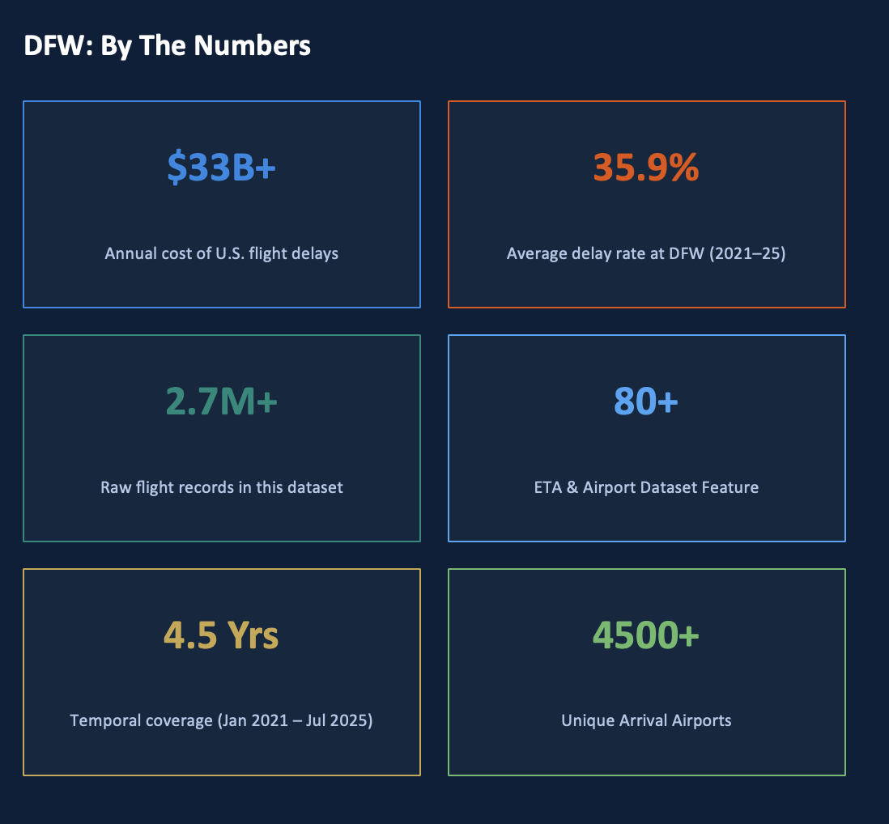
Problem Statement & Research Questions
Research questions and real-world operational value
Problem Statement
Current airline systems report flight delays reactively - passengers and airline personnel know about delays after they happen. Here we create a predictive, data-driven ML pipeline that predicts whether a DFW flight will be delayed (binary classification) and how many minutes late it will be (regression) using real-time in-flight ETD messages and hourly DFW weather at the hour of departure as input features.
Research Questions
Binary Classification
RQ1
Can we accurately predict whether a DFW flight will arrive delayed using in-flight ETD messages and weather conditions?
Delay Magnitude
RQ2
How many minutes of arrival delay can be predicted from departure signals — and which features drive the predicted duration?
Weather Impact
RQ3
Which DFW weather variables (precipitation, weathercode, pressure) are most statistically significant predictors of delay?
Model Generalizability
RQ4
Can a temporally trained model generalize to held-out future flights without data leakage across a 70/20/10 split?
Flight Delay Prediction — DFW | ADTA 5940 Capstone | GROUP-8 | University of North Texas
5

Slide 5
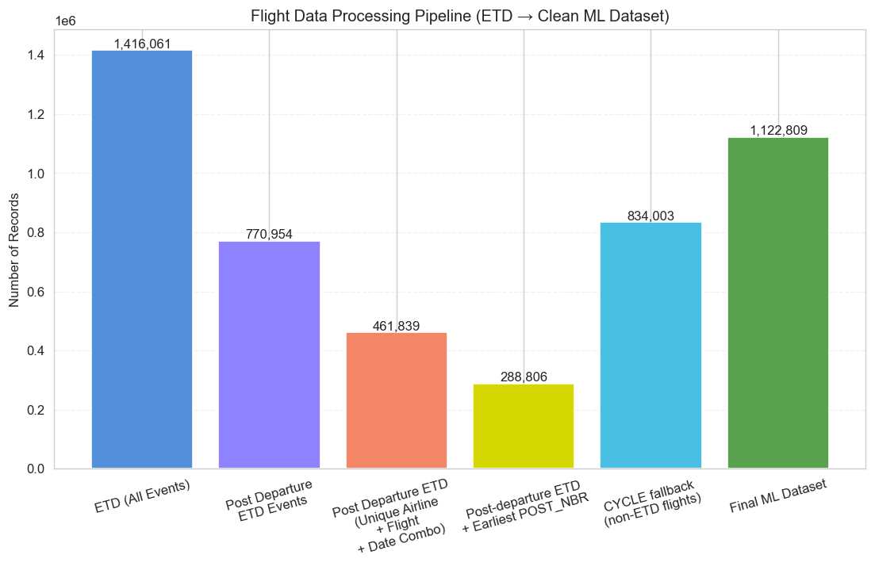
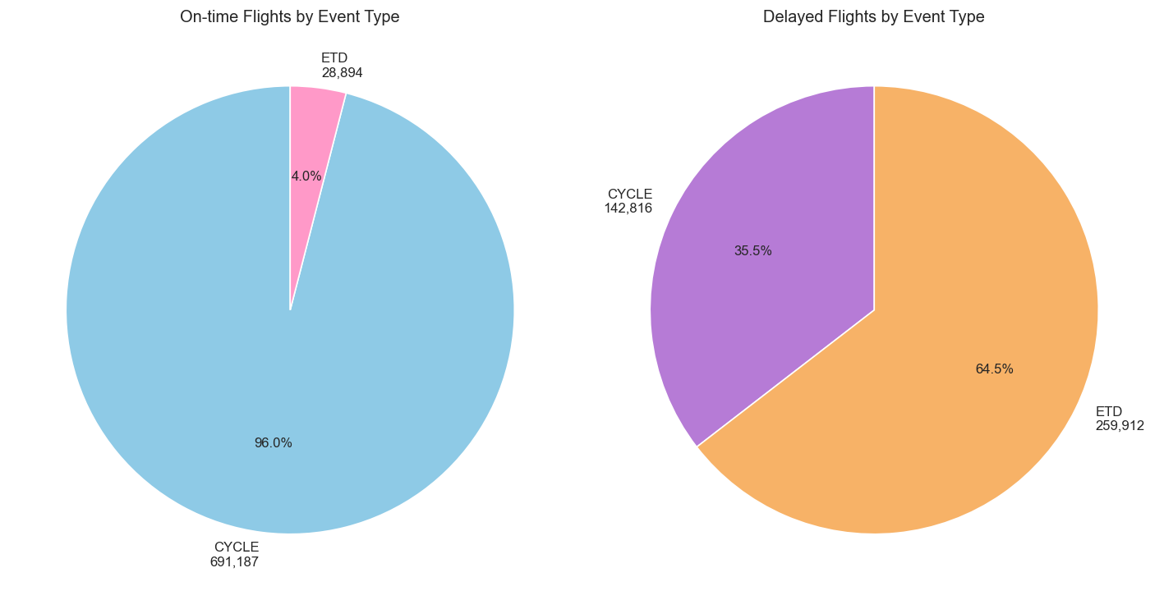
Data Filtering Pipeline
ETD event selection strategy & class balance
Figure 1 — Flight Data Processing Pipeline
Figure 2 — Class Balance by Event Type
288,806
834,003
1,122,809
35.9%
ETD in-flight records
CYCLE fallback records
Final ML dataset
Overall delay rate
▲ ETD flights have the highest signal richness — in-air transmissions give real-time departure status. CYCLE records fill coverage for flights without ETD updates.
Flight Delay Prediction — DFW | ADTA 5940 Capstone | GROUP-8 | University of North Texas
7

Slide 6
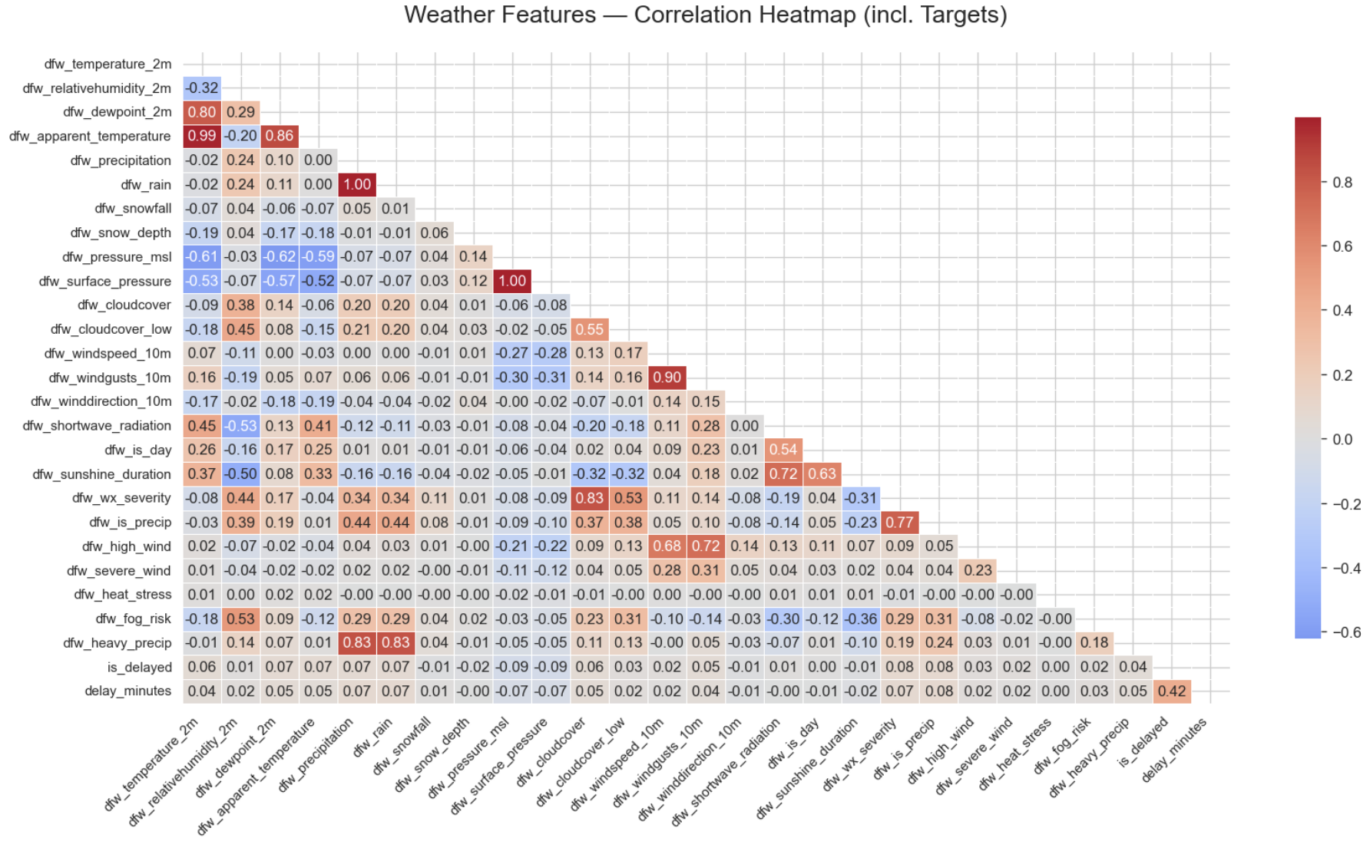
Weather Data Integration - DFW (2021–2025)
Open-Meteo API: 20 variables at exact departure hour
Full Weather Correlation Heatmap (incl. Targets)
Weather Statistics
Feature | Mean | Std | Min | 50%
dfw_temperature_2m | 21.2 | 9.9 | -17.5 | 22.4
dfw_pressure_msl | 1016.1 | 6.8 | 992.8 | 1015.2
dfw_surface_pressure | 994.9 | 6.2 | 972.2 | 994.4
dfw_dewpoint_2m | 12.076 | 9.084 | -27.0 | 14.5
dfw_apparent_temperature | 20.760 | 12.219 | -22.7 | 22.4
dfw_relativehumidity_2m | 59.882 | 20.081 | 8.0 | 60.0
dfw_rain | 0.166 | 0.961 | 0.0 | 0.0
dfw_winddirection_10m | 169.874 | 90.475 | 0.0 | 170.0
Weather Parameters Summary
Category | Variables
Temperature | temp_2m, apparent_temp, dewpoint_2m
Precipitation | precipitation, rain, snowfall, snow_depth
Pressure | pressure_msl, surface_pressure
Wind | windspeed_10m, windgusts_10m, winddirection
Cloud / Vis | cloudcover, cloudcover_low, weathercode
Solar / Time | shortwave_radiation, sunshine_duration, is_day
Derived Flags | wx_severity, is_precip, high_wind, fog_risk
Key: Pressure drop & precipitation flags are the strongest weather signals. Weathercode (WMO) captures storm severity.
Flight Delay Prediction — DFW | ADTA 5940 Capstone | GROUP-8 | University of North Texas
9

Slide 7
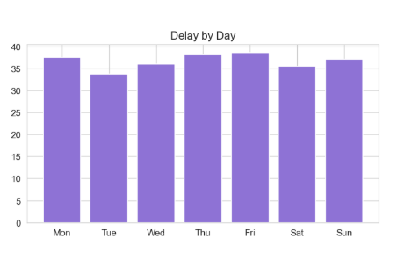
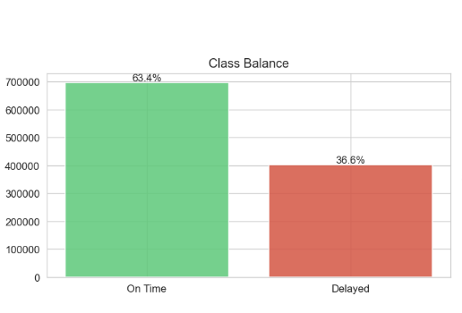
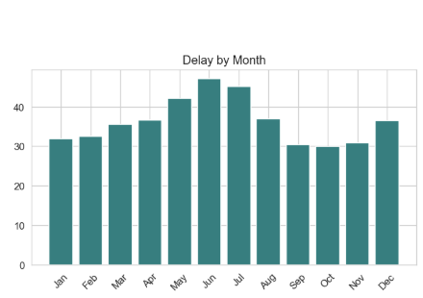
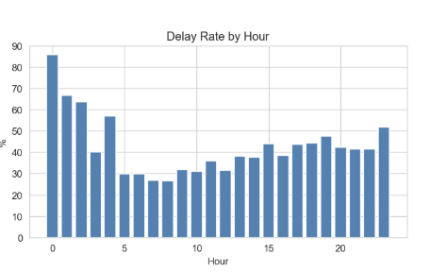
Exploratory Data Analysis
Temporal delay patterns across hours, days, and months
Key EDA Observations
Hour Effect
Delays peak at midnight (85%) and rise steadily from 4 PM, reflecting compounding network effects and evening congestion.
Seasonal
Summer (Jun–Jul) peaks at 43%+ delay rate — convective storm season in DFW. October lowest.
Day Pattern
Thursday & Friday show highest delays — business travel peaks. Sunday surprisingly low.
ETD Signal
Strong linear relationship between ETD push and arrival delay — validates ETD as core predictor.
Flight Delay Prediction — DFW | ADTA 5940 Capstone | GROUP-8 | University of North Texas
10

Slide 8
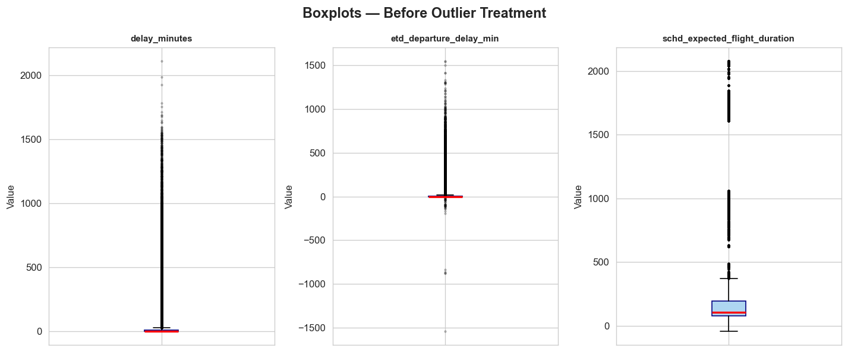
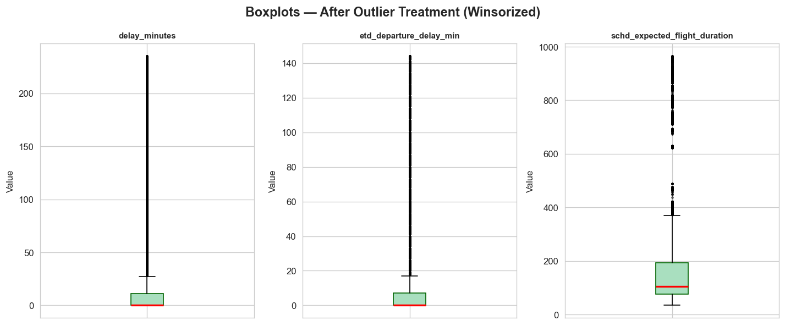
Data Preparation & Feature Engineering
Cleaning, outlier treatment, and feature construction
Outlier Treatment — Before & After Winsorization
Before Outliers
After Outliers
Feature Engineering Summary
Feature | Type | Description
MINS_TO_SCHD_DEP_QTY | ETD Signal | Minutes from ETD message to scheduled departure (negative = in-air)
etd_departure_delay_min | ETD Signal | ETD-to-scheduled-departure offset in minutes
etd_volatility_min | ETD Signal | Variance across ETD message updates for same flight
peak_x_etd_delay | Interaction | Peak-hour flag × ETD delay product
flight_nbr_hist_delay_rate | Historical | Expanding mean delay rate per flight number (no leakage)
dep_month_sin / cos | Temporal | Cyclical encoding of departure month
dfw_weathercode | Weather | WMO weather condition code at departure hour
Feature | Type | Description
FLIGHT_DISTANCE_KME | Route | Circle distance between origin and destination (km), captures route length and baseline travel time
route_freq | Route | Historical frequency of the route ( DFW_ARRIVAL )
schd_expected_flight_duration | Route | Baseline expected travel time calculated as the difference between scheduled arrival and departure
peak_x_distance | Interaction | Peak-hour flag × distance
updates_so_far | ETD Signal | Number of updates received for the flight; proxy for monitoring intensity and disruption.
dep_hour / dayofweek / month / is_weekend / is_holiday_season / is_peak_hour / year | Temporal | Departure-time features capturing hourly, weekly, and seasonal patterns along with flags for weekend, holiday season, and peak traffic periods.
Flight Delay Prediction — DFW | ADTA 5940 Capstone | GROUP-8 | University of North Texas
11

Slide 9
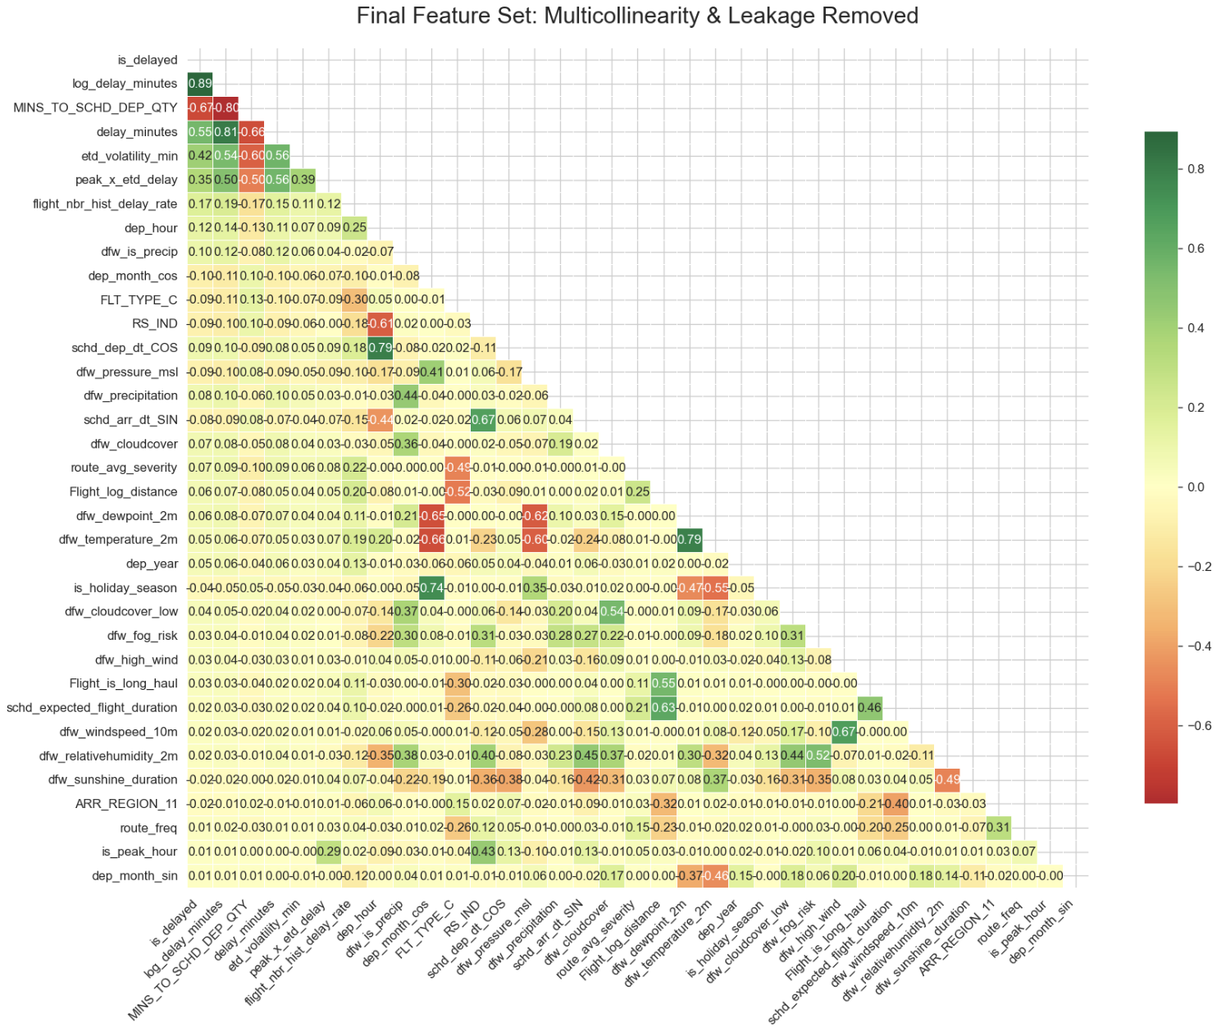
Feature Selection & Modeling Approach
Leakage-free temporal split with 37 final features
Modeling Strategy
Task 1 — Classification (Predict whether a flight departing from DFW will arrive delayed)
Predict is_delayed (binary)
Threshold optimized via F1
Task 2 — Regression ( Estimate the expected arrival delay in minutes )
Predict log(delay_minutes)
Back-transformed to minutes
Temporal Train / Test / Val Split
Split | Rows | Period
Train (70%) | 767,326 | Jan 2021 – ~Sep 2024
Test (20%) | 219,236 | Sep 2024 – ~May 2025
Validation (10%) | 109,619 | May 2025 – Jul 2025
Flight Delay Prediction — DFW | ADTA 5940 Capstone | GROUP-8 | University of North Texas
12

Slide 10
Classification Model — Parameters & Results
4 models trained on 70/20/10 temporal split | Best: XGBoost (AUC 0.8745, Accuracy 85.56%)
Model | Key Parameters
Logistic Regression | penalty=l1, C=0.1, solver=saga, max_iter=2000, class_weight=balanced
Random Forest | n_estimators=200, max_depth=15, min_samples_leaf=5, class_weight=balanced_subsample
XGBoost | n_estimators=300, max_depth=6, lr=0.05, subsample=0.8, colsample=0.8, min_child_weight=5
LightGBM | n_estimators=300, max_depth=6, learning_rate=0.05, subsample=0.8, colsample_bytree=0.8, class_weight='balanced’, randomstate=42, n_jobs=-1, verbose=-1
Model | Train Acc | Train AUC | Train Recall (Delay) | Test Acc | Test AUC | Test F1 | Test Recall (Delay)
XGBoost🥇 | 84.87% | 0.8758 | 0.6604 | 85.56% | 0.8745 | 0.7851 | 0.6958
LightGBM | 84.77% | 0.8715 | 0.6357 | 85.54% | 0.8736 | 0.7850 | 0.6959
Random Forest | 84.87% | 0.8719 | 0.6563 | 85.68% | 0.8693 | 0.7833 | 0.6826
Logistic Reg. | 84.61% | 0.8285 | 0.6291 | 85.68% | 0.8566 | 0.7835 | 0.6831
Regression Model — Parameters & Results
2 models trained on 70/20/10 temporal split | Best: XGBoost (Test R² 0.7314)
Model | Key Parameters
XGBoost Regressor | n_estimators=500, max_depth=6, learning_rate=0.05, subsample=0.8, colsample_bytree=0.8, random_state=42, n_jobs=-1
LightGBM Regressor | n_estimators=300, learning_rate=0.05, num_leaves=31, max_depth=-1, subsample=0.8, colsample_bytree=0.8, random_state=42, n_jobs=-1, verbose=-1
Model | Train MAE | Train RMSE | Train R² | Test MAE | Test RMSE | Test R²
XGBoost Reg 🥇 | 7.9094 | 22.2945 | 0.7269 | 9.7195 min | 25.5799 min | 0.7314
LightGBM Reg | 8.0484 | 22.6556 | 0.7169 | 9.7050 min | 25.6106 min | 0.7295
Flight Delay Prediction -- DFW | ADTA 5940 Capstone | GROUP-8 | University of North Texas

Slide 11
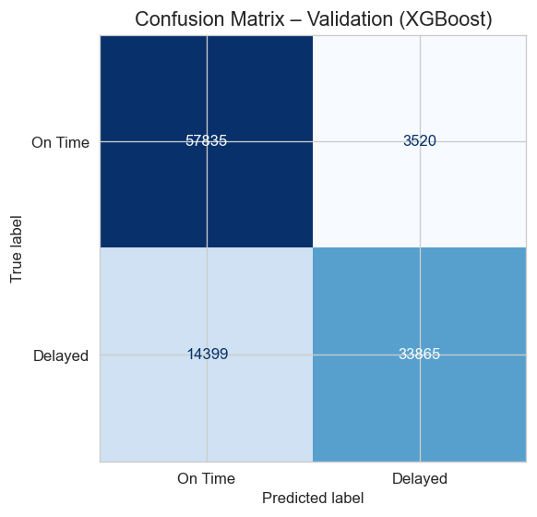
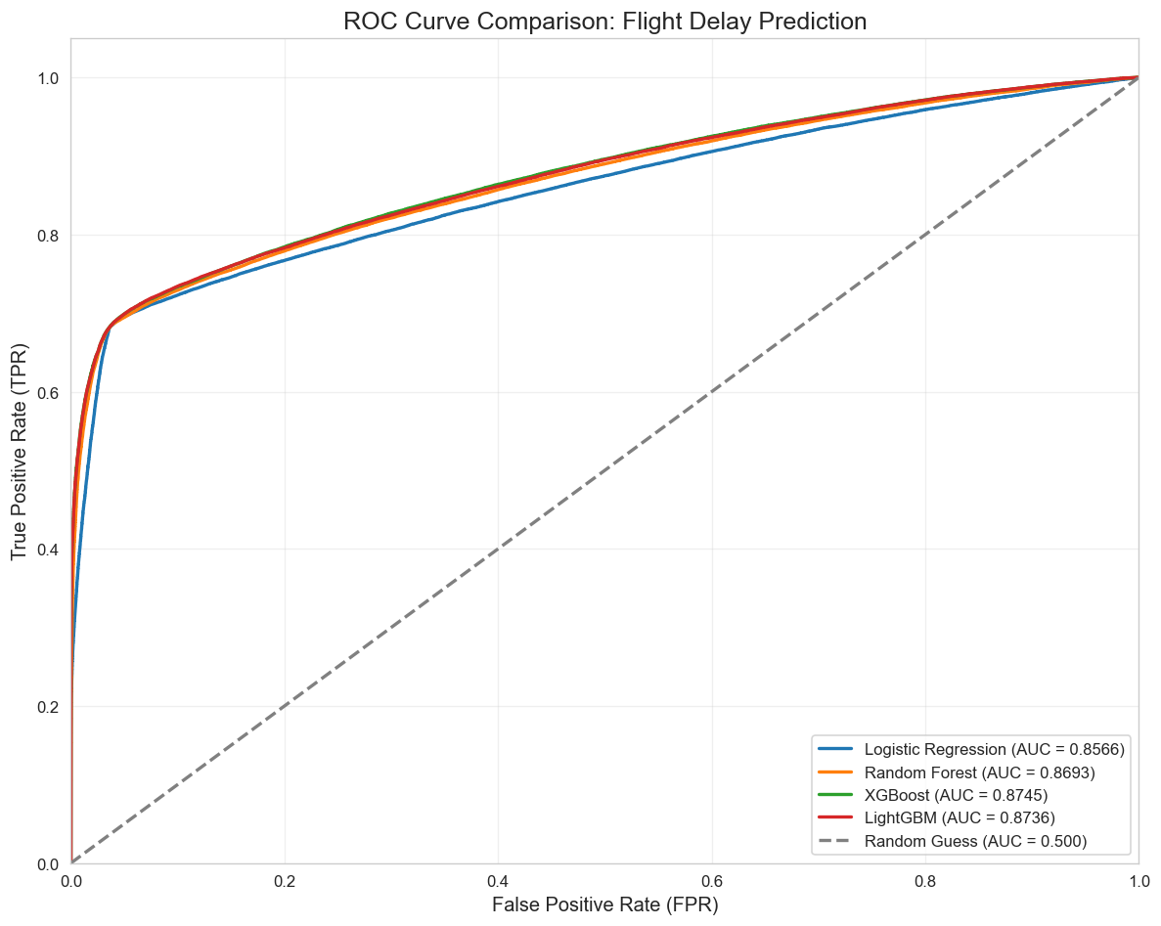
Classification Results — Delay Detection
Which flights will arrive late?
ROC Curve Comparison (Validation Set)
Confusion Matrix — XGBoost Validation
Model | Test Acc | Test AUC | Test F1
Test | 85.56% | 0.8745 | 0.7851
Validation | 83.65% | 0.8712 | 0.7900
Metric | Count
True Negatives (On Time, correct) | 57,835
True Positives (Delayed, correct) | 33,865
False Positives (False Alarm) | 3,520
False Negatives (Missed Delay) | 14,399
Flight Delay Prediction — DFW | ADTA 5940 Capstone | GROUP-8 | University of North Texas
13

Slide 12
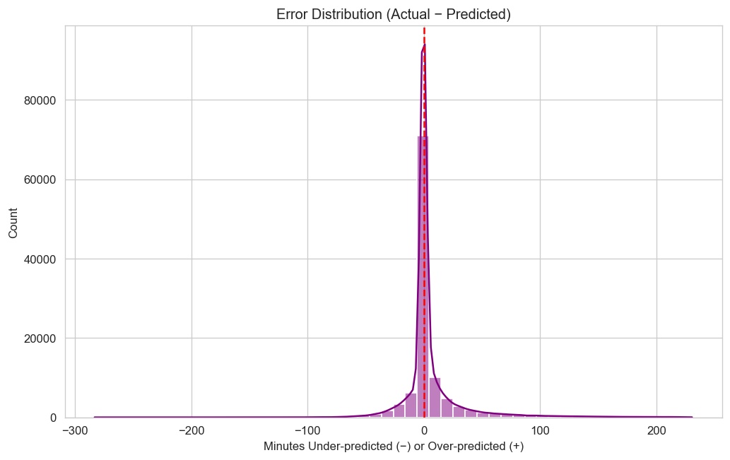
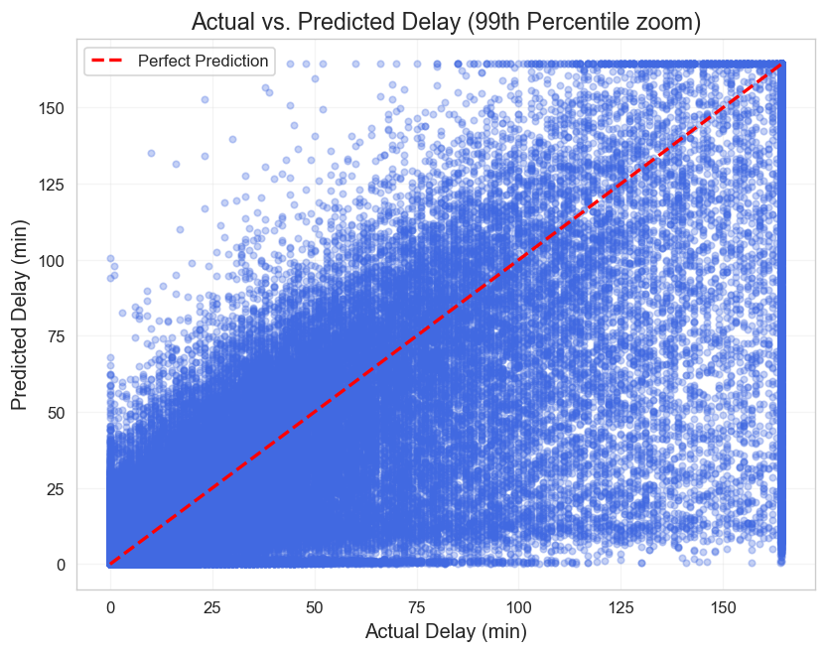
Regression Results — Delay Magnitude
How many minutes will the flight be late?
Actual vs. Predicted Delay — XGBoost (Test)
Residual Distribution
Regression Model Leaderboard
Key Regression Metrics (Validation)
Model | MAE (min) | RMSE (min) | R²
🥇 XGBoost Reg (Test) | 9.7195 | 25.5799 | 0.7314
LightGBM Reg (Test) | 9.7050 | 25.6106 | 0.7295
XGBoost Reg (Val) | 11.38 | 27.28 | 0.7232
MAE
11.3 min
R²
0.7232
Bias
+5.56 min
RMSE
27.2 min
Flight Delay Prediction — DFW | ADTA 5940 Capstone | GROUP-8 | University of North Texas
14

Slide 13
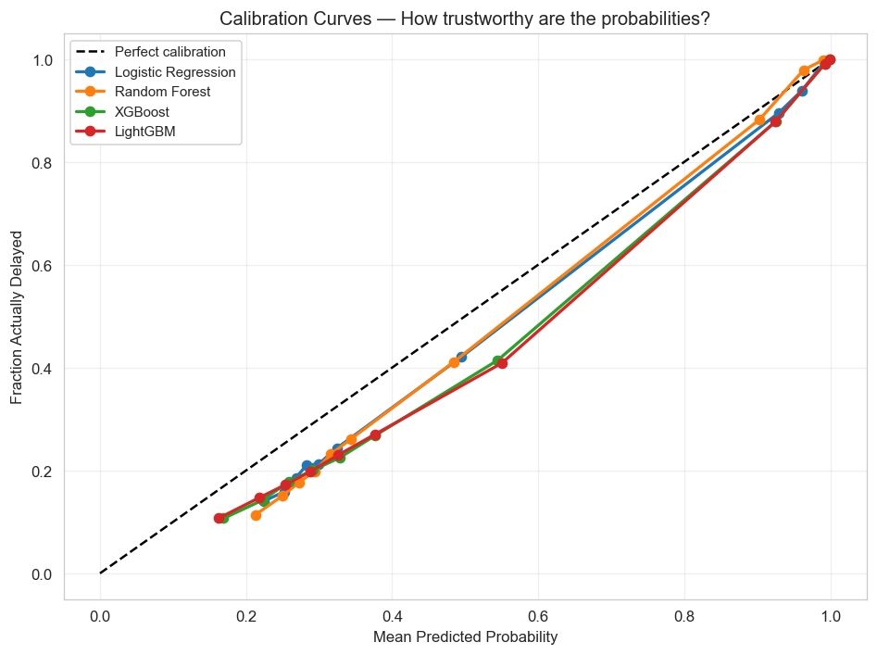
Hyperparameter Tuning
Hyperparameter Tuning
RandomizedSearchCV on XGBoost (Classifier + Regressor) | 15–25 iterations, 3-fold CV
RandomizedSearchCV on XGBoost (Classifier + Regressor) | 15–25 iterations, 3-fold CV
Hyperparameter Tuning — RandomizedSearchCV (3-fold CV)
Task | Search Space (Key Params) | n_iter / CV | Scoring | Best Params Found
XGB Classifier | n_estimators [300,500], max_depth [4,6,8], lr [0.01,0.05,0.1], min_child_weight [1,5,10], gamma [0,0.1,0.2], subsample [0.7-0.9], colsample [0.7-0.9] | 15 / 3-fold | AUC-ROC | subsample=0.7, n_est=500, min_child=5, max_depth=4, lr=0.01, gamma=0, colsample=0.8
XGB Regressor | n_estimators [600-800], max_depth [5,6,7], lr [0.03-0.07], subsample [0.8-1.0], colsample [0.8-1.0], min_child [1,3,5], reg_alpha [0-0.1], reg_lambda [1-2] | 25 / 3-fold | neg_MAE | subsample=0.9, reg_lambda=2, reg_alpha=0.1, n_est=700, min_child=1, max_depth=5, lr=0.03, colsample=1.0
>> Before vs After Tuning & Best Model Selection
Model | Accuracy | Recall (Del.) | F1 (Del.) | AUC - ROC
XGBoost (Tuned) | 0.86 | 0.69 | 0.7844 | 0.8705
XGBoost (Default) | 0.8556 | 0.6958 | 0.7851 | 0.8745
Model | MAE (min) | RMSE (min) | R²
XGBoost (Tuned) | 9.73 | 25.60 | 0.7304
XGBoost (Default) | 9.719 | 25.580 | 0.731
Flight Delay Prediction -- DFW | ADTA 5940 Capstone | GROUP-8 | University of North Texas

Slide 14
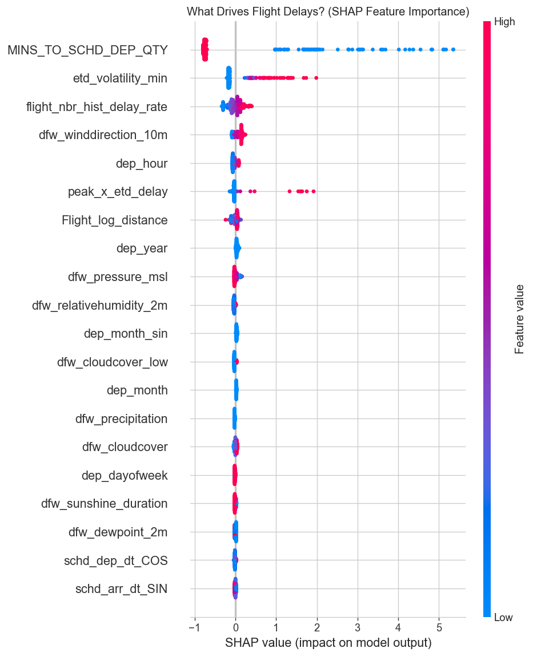
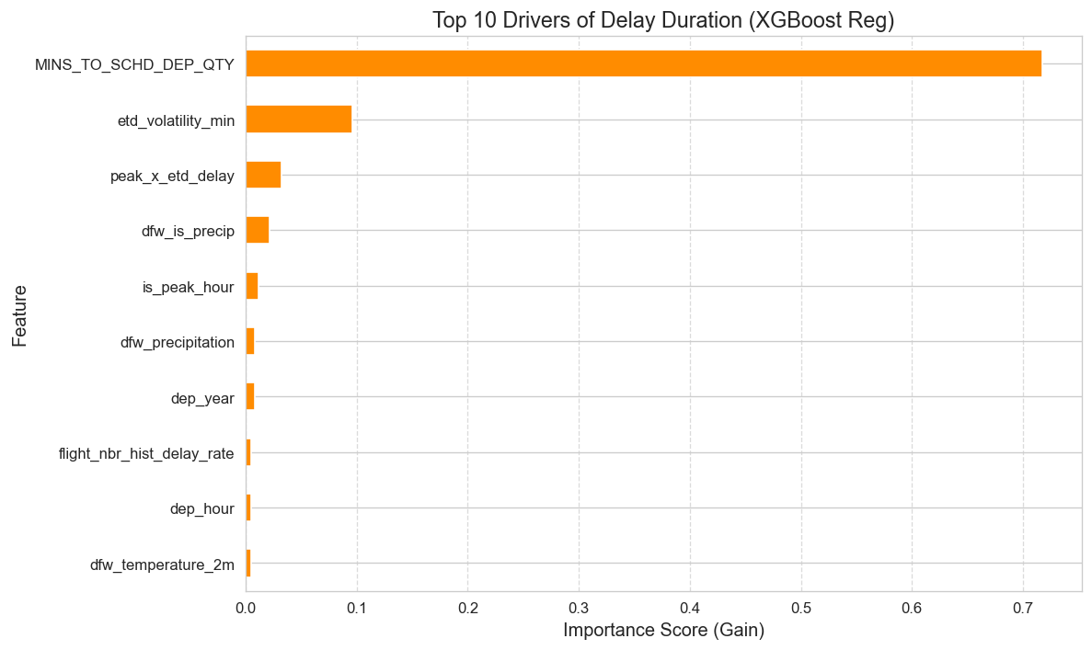
SHAP Feature Importance & Delay Drivers
What drives the model's predictions?
SHAP Values — Tuned XGBoost Classifier
Top 10 Drivers — XGBoost Regressor
Feature | Direction | Interpretation
MINS_TO_SCHD_DEP_QTY | ↑ High → ↓ delay | Longer pre-dep window = less rush = less delay
etd_volatility_min | ↑ High → ↑ delay | Volatile ETD = operational instability
flight_nbr_hist_delay_rate | ↑ High → ↑ delay | Historically problematic routes/numbers
peak_x_etd_delay | ↑ High → ↑ delay | Peak-hour + ETD push = worst affected
dfw_pressure_msl | ↓ Low → ↑ delay | Low pressure = storm systems at DFW
Flight Delay Prediction — DFW | ADTA 5940 Capstone | GROUP-8 | University of North Texas
15

Slide 15
Discussion, Limitations & Future Work
Discussion, Limitations & Future Work
Research Question Answers
Limitations
Future Work
RQ1 — Binary Classification
Single Airport Scope
Multi-Airport Modeling
The model is limited to DFW airport only and does not account for delay propagation from connected hubs such as ORD or ATL.
Expand the model to capture delay propagation across multiple airports, especially from major origin hubs.
Yes. XGBoost achieves AUC ≈ 0.87, Accuracy ≈ 85%, and F1 ≈ 0.78 on validation data, correctly identifying ~70% of delayed flights with a low false alarm rate (~6%).
Weather Granularity
Advanced Models (LSTM / Transformer)
Weather data is captured at an hourly level, which may miss short-duration events like microbursts or sudden wind shear.
Move from gradient boosting to sequence-based models like LSTM or Transformers to better capture time-series dependencies along flight routes.
RQ2 — Delay Magnitude
Yes. XGBoost Regressor achieves MAE ≈ 11.6 min and R² ≈ 0.72 on validation, providing useful delay estimates with slight overprediction (+4.4 min bias).
Class Imbalance
Real-Time API Integration
The dataset is skewed (64% vs. 36%), which may underrepresent extreme delays (>2 hours), contributing to an RMSE of 25.38 minutes.
Develop a REST API that ingests live data sources such as ARINC, SITA, and Open-Metro for real-time predictions.
RQ3 — Weather Variables
Pressure_msl, surface_pressure, is_precip, and wx_severity are top weather signals. ETD operational features still dominate SHAP rankings over weather.
Feature Availability
Destination Weather Integration
Certain features, such as Estimated Time of Departure (ETD), are only available after departure, limiting real-time prediction capability.
Incorporate arrival airport weather data to improve model accuracy, with an expected R² increase of approximately 0.08–0.12.
RQ4 — Generalizability
Regression Bias
Additional Data Sources
Strong generalization with minimal overfitting (Train–Test AUC gap ≈ 0.0012), supported by temporal splitting and leakage-free feature engineering.
The model tends to overpredict delays by an average of +5.9 minutes, likely due to handling of extreme values (e.g., Winsorization).
Enhance the model using more inputs such as ATC ground delay programs, NOTAMs, and gate utilization data.
Flight Delay Prediction — DFW | ADTA 5940 Capstone | GROUP-8 | University of North Texas

Slide 16
Business Outcomes & Conclusion
Operational impact for airlines, airports & passengers | Key findings
0.8743
85.56%
69.58%
9.73 min
0.7314
AUC-ROC
Accuracy
Delay Recall
Reg. MAE
R² Score
Airline Operations
Airport Authority
Passengers
Proactive crew & gate reassignment
Reduce reactionary delay cascades
ETD-triggered ground hold optimization
Route-level delay risk monitoring
Real-time slot allocation decisions
Weather-based runway prioritization
Staff scheduling for peak delay windows
Cargo/baggage throughput planning
Advance delay alerts (6–12 hours)
Confident connection planning
Reduced uncertainty at gate
Improved overall travel experience
Conclusion — Key Takeaways
Dual ML pipeline (classification + regression) predicting DFW flight arrival delays from 1.1M flights across 4.5 years.
XGBoost achieves AUC ≈ 0.87 for delay detection, while LightGBM predicts delay duration with MAE ≈ 11.38 minutes on validation data..
In-flight ETD signals dominate SHAP rankings. Weather adds meaningful marginal signal (pressure_msl, is_precip). Afternoon departure hour is a persistent risk independent of other features.
Strict temporal splitting + expanding-mean encoding prevent data leakage. Train–Test AUC gap = 0.0012 (Strong generalization with minimal overfitting).
Framework is production-ready, enabling real-time delay prediction and a shift from reactive to proactive airline operations.
Flight Delay Prediction — DFW | ADTA 5940 Capstone | GROUP-8 | University of North Texas

Slide 17
